Slide 1
Computational Geometry & Number Theory
Segment 7

Slide 2
Computational geometry is the branch of computer science that studies algorithms for solving geometric problems.
The input to a computational-geometry problem is typically a description of a set of geometric objects, such as a set of points, a set of line segments, or the vertices of a polygon in counterclockwise order.
In this chapter, we look at a few computational-geometry algorithms in two dimensions, that is, in the plane. Each input object is represented as a set of points {p₁, p₂, p₃, ...}, where each p_{i} = (x_{i,} y_{i}) and x_{i}, y_{i}∈R.

Slide 3
Application Areas
Computer Graphics
Computer-aided design / manufacturing
Telecommunication
Geology
Architecture
Geographic Information Systems
VLSI design (chip layout)
...

Slide 4
Line-segment properties
A convex combination of two distinct points p₁ = (x₁, y₁) and p₂ = (x₂, y₂) is any point p₃ = (x₃, y₃) such that for some α in the range 0≤α≤1, we have x₃ =αx₁ + (1 - α)x₂ and y₃ = αy₁ + (1 - α)y₂. We also write that p₃ = αp₁ + (1 - α)p₂.
Reference: Introduction to Algorithms (2n Edition)- Cormen;
Chapter 33; Computational Geometry

Slide 5
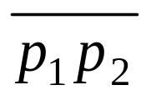
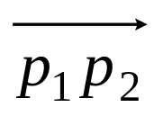
Given two distinct points p₁ and p₂, the line segment is the set of convex combinations of p₁ and p₂.
We call p₁ and p₂ the endpoints of segment
.
Sometimes the ordering of p₁ and p₂ matters, and we speak of the directed segment .
If p₁ is the origin (0, 0), then we can treat the directed segment as the vector p₂.

Slide 6
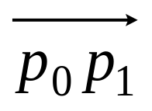
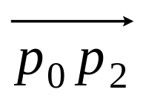
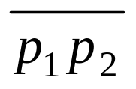
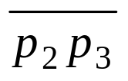
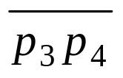
In this section, we shall explore the following questions:
1. Given two directed segments and , is clockwise from with respect to their common endpoint p₀?
2. Given two line segments and , if we traverse and then , do we make a left turn at point p₁?
3. Do line segments and intersect?
We can answer each question in O(1) time.

Slide 7
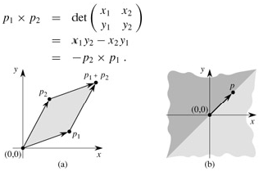
Cross products
If p₁×p₂ is positive, p₁ is clockwise from p₂ with respect to the origin (0,0); if negative, p₁ is counterclockwise from p₂. Fig (b) shows the clockwise and counterclockwise regions relative to a vector p. the lightly shaded region contains vector that are clockwise from p. the darkly shaded region contains vectors that are counterclockwise from p. A boundary condition arises if the cross product is 0; in this case, the vectors are collinear, pointing in either the same or opposite directions.

Slide 8
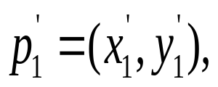
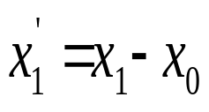
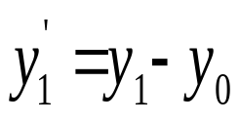
Whether a directed segment clockwise or counterclockwise
To determine whether a directed segment is clockwise from a directed segment with respect to their common end point p₀ , we simply translate to use p₀ as the origin. Let p₁ - p₀ denote the vector where and
Define p₂ - p₀ similarly. Then compute the cross product
(p₁ - p₀) × (p₂ - p₀)=(x₁ - x₀)(y₂ - y₀)-(x₂ - x₀)(y₁ - y₀)
If this cross product is positive, is clockwise from ; if negative, it is counterclockwise.

Slide 9
Determining whether consecutive segments turn left or right
To do this, we compute the cross product (p₂ - p₀) × (p₁ - p₀). If the sign of this cross product is negative, then is counterclockwise with respect to , and thus we make a left turn at p₁. A positive cross product indicates a clockwise orientation and a right turn. A cross product of 0 means that points p₀, p₁, and p₂ are collinear.

Slide 10
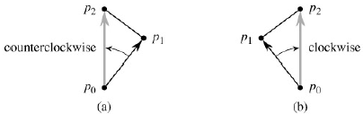
Using the cross product to determine how consecutive line segments and turn at point p₁. We check whether the directed segment is clockwise or counterclockwise relative to the directed segment . (a) If counterclockwise, the points make a left turn. (b) If clockwise, they make a right turn.

Slide 11
Determining whether two line segments intersect
A segment p₁p₂ straddles a line if point p₁ lies on one side of the line and point p₂ lies on the other side.
Two line segments intersect if and only if either (or both) of the following conditions holds:
Each segment straddles the line containing the other.
An endpoint of one segment lies on the other segment. (This condition comes from the boundary case.)

Slide 12
SEGMENTS-INTERSECT(p₁, p₂, p₃, p₄)
1 d₁ ← DIRECTION(p₃, p₄, p₁)
2 d₂ ←DIRECTION (p₃, p₄, p₂)
3 d₃ ←DIRECTION (p₁, p₂, p₃)
4 d₄ ←DIRECTION (p₁, p₂, p₄)
5 if ((d₁ > 0 and d₂ < 0) or (d₁ < 0 and d₂ > 0)) and ((d₃ > 0 and d₄ < 0) or (d₃ < 0 and d₄ > 0))
6 then return TRUE
7 elseif d₁ = 0 and ON-SEGMENT(p₃, p₄, p₁)
8 then return TRUE
9 elseif d₂ = 0 and ON-SEGMENT(p₃, p₄, p₂)
10 then return TRUE
11 elseif d₃ = 0 and ON-SEGMENT(p₁, p₂, p₃)
12 then return TRUE
13 elseif d₄ = 0 and ON-SEGMENT(p₁, p₂, p₄)
14 then return TRUE
15 else return FALSE

Slide 13
DIRECTION (p_{i}, p_{j}, p_{k})
1. return (p_{k} - p_{i}) × (p_{j} - p_{i})
ON-SEGMENT(p_{i}, p_{j}, p_{k})
1. if (min(x_{i}, x_{j}) ≤ x_{k} ≤ max(x_{i}, x_{j}) and min(y_{i}, y_{j}) ≤ y_{k} ≤ max(y_{i}, y_{j}))
2. then return TRUE
3. else return FALSE

Slide 14
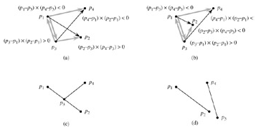

Slide 15
Convex vs. Concave
Convex Hull
A polygon P is convex if for every pair of points x and y in P, the line xy is also in P; otherwise, it is called concave.
x
P
x
y
P
y
concave
convex

Slide 16
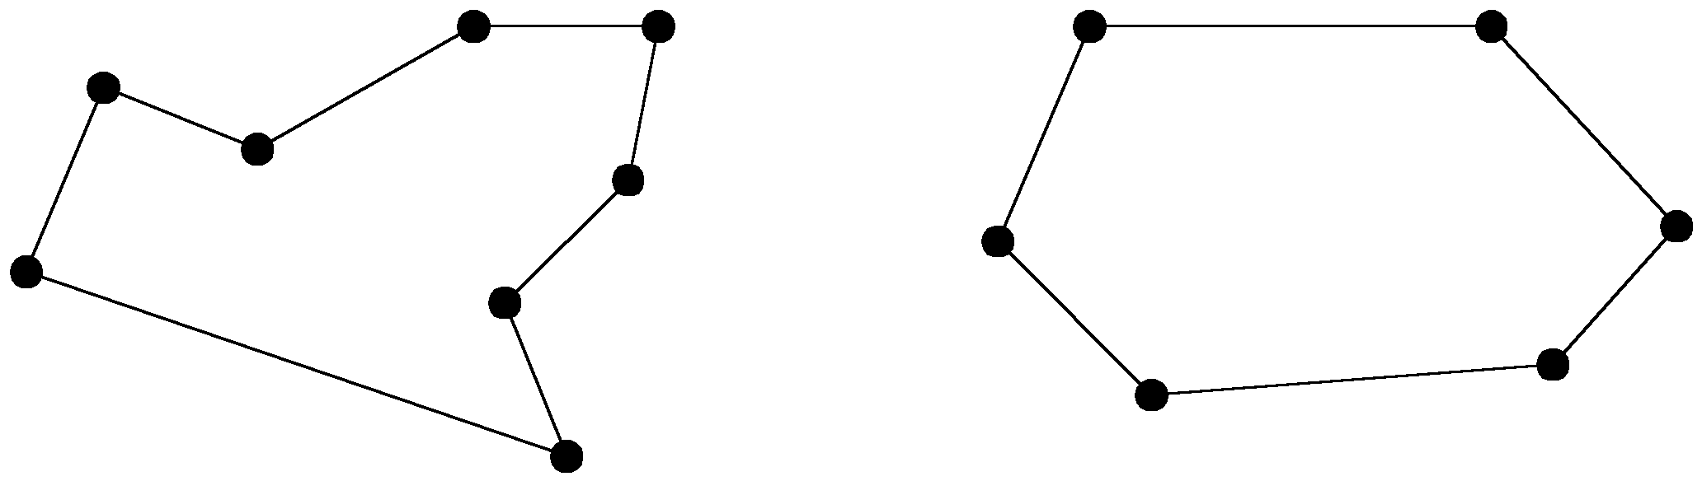
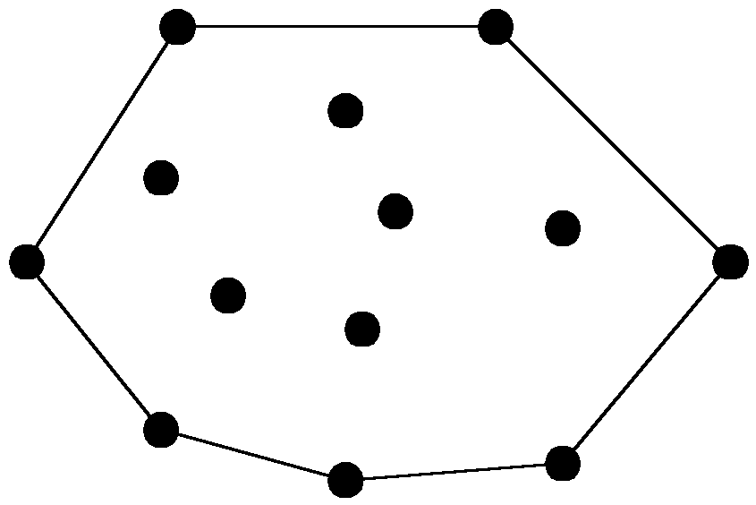
The convex hull problem
concave polygon:
convex polygon:
The convex hull of a set of planar points is the smallest convex polygon containing all of the points.

Slide 17
Graham’s Scan
Start at point guaranteed to be on the hull. (the point with the minimum y value)
Sort remaining points by polar angles of vertices relative to the first point.
Go through sorted points, keeping vertices of points that have left turns and dropping points that have right turns.
Notes:
Positive cross product is right turn, negative is left turn

Slide 18
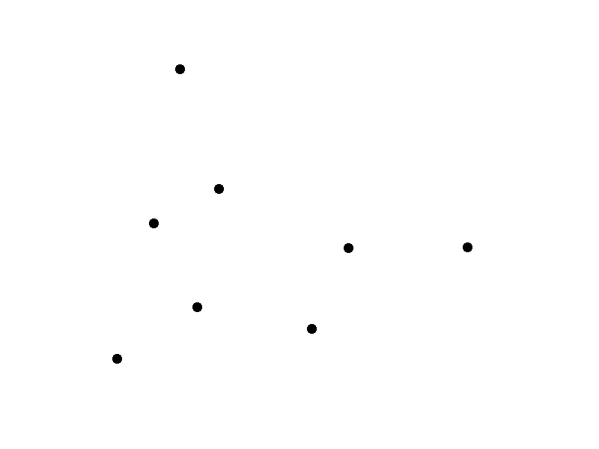
Graham’s Scan

Slide 19
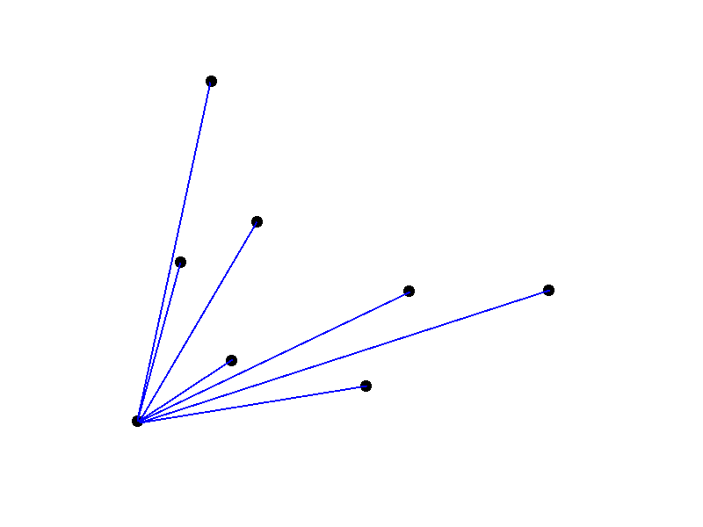
Graham’s Scan

Slide 20
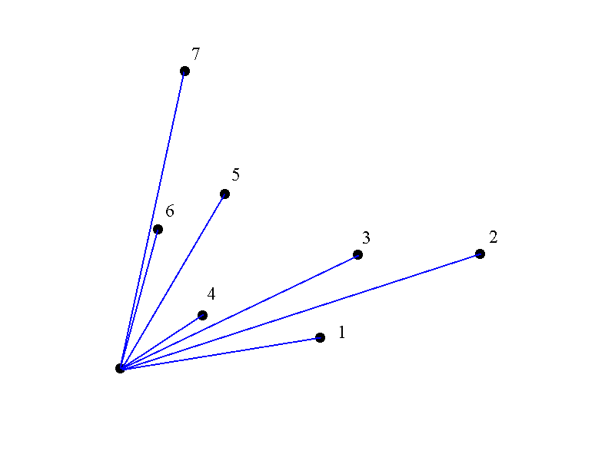
Graham’s Scan

Slide 21
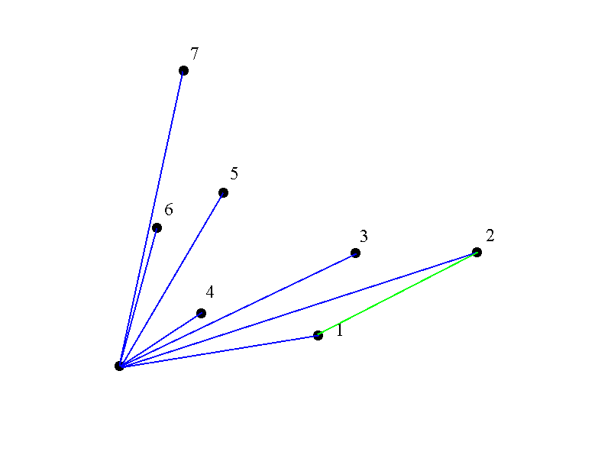
Graham’s Scan

Slide 22
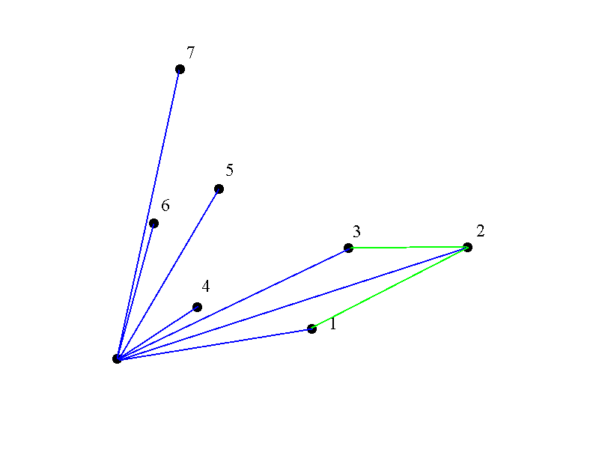
Graham’s Scan

Slide 23
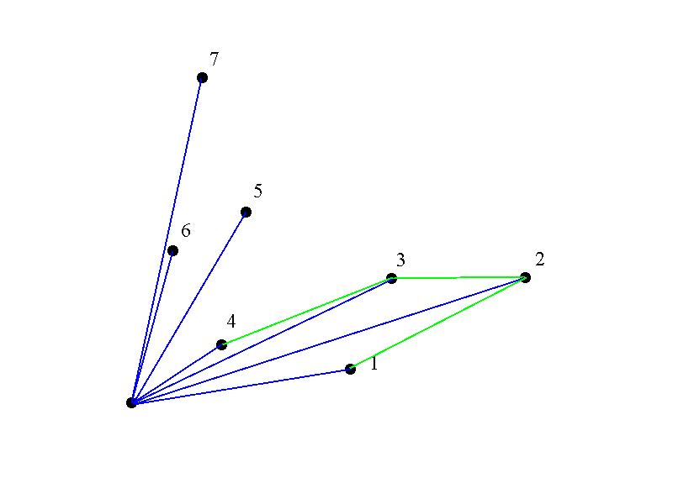
Graham’s Scan

Slide 24
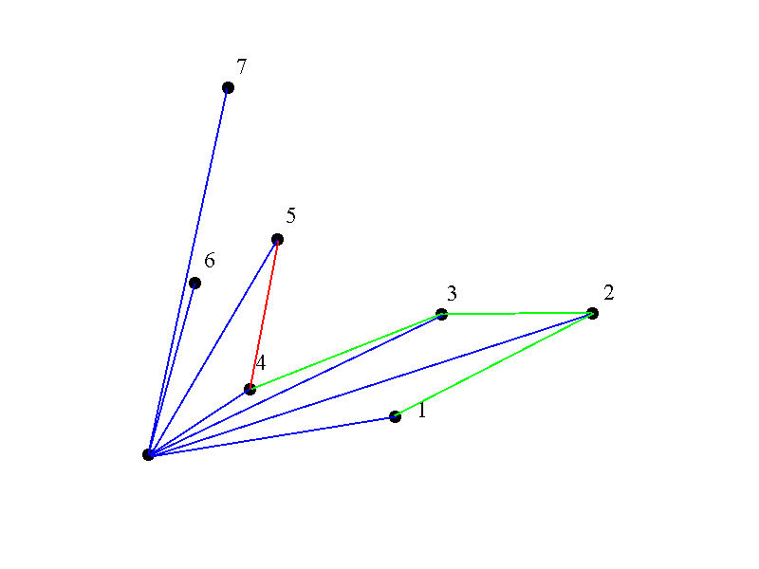
Graham’s Scan

Slide 25
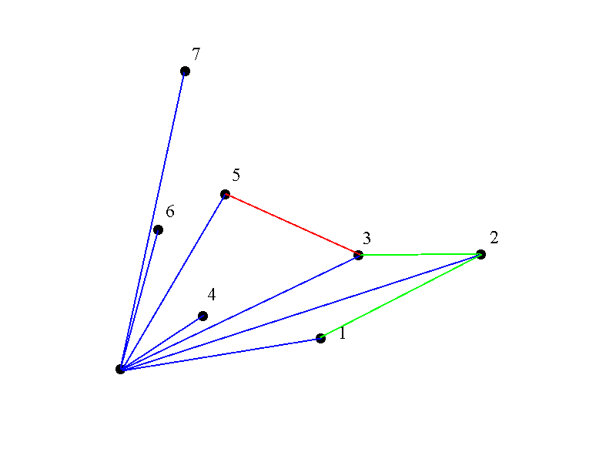
Graham’s Scan

Slide 26
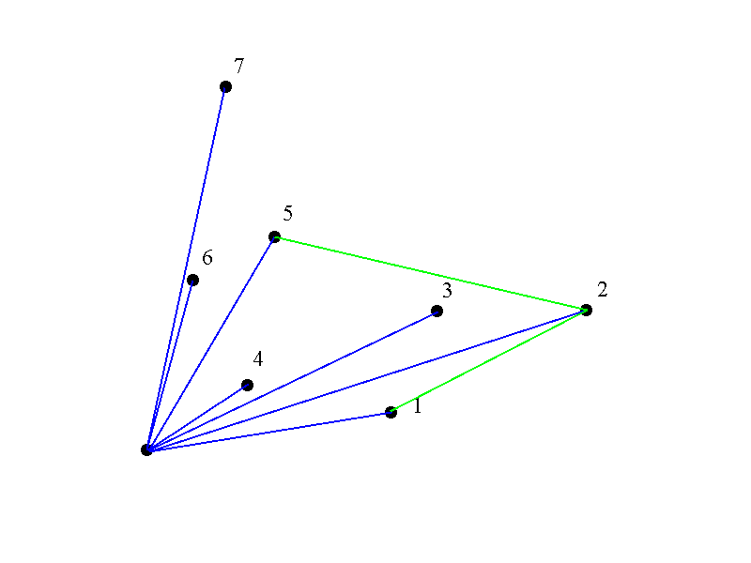
Graham’s Scan

Slide 27
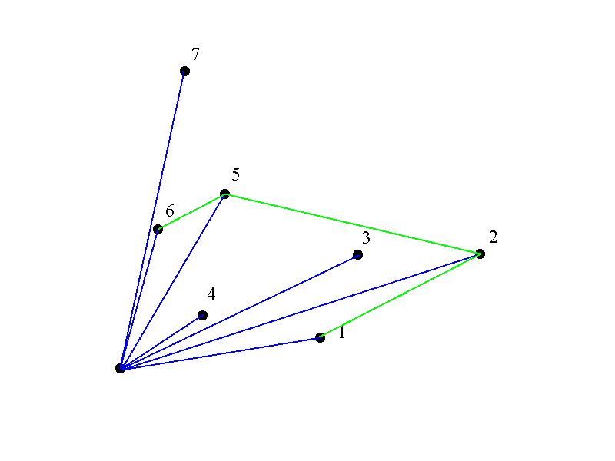
Graham’s Scan

Slide 28
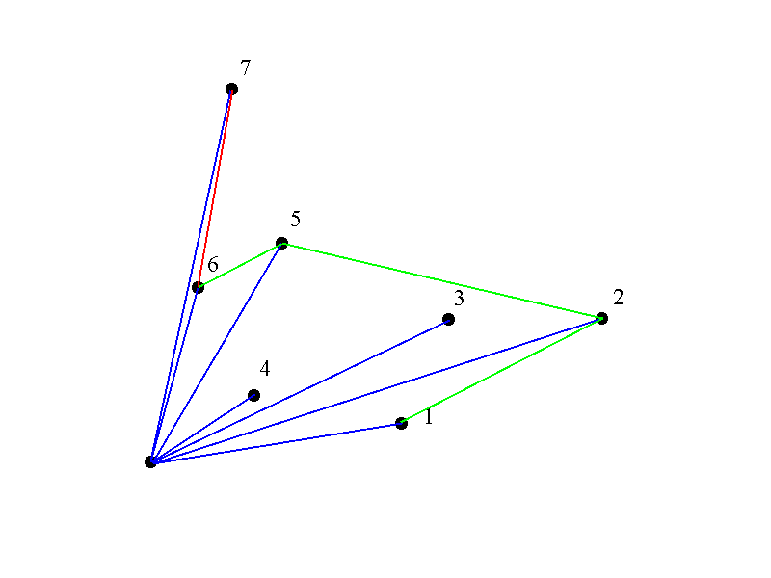
Graham’s Scan

Slide 29

Graham’s Scan

Slide 30
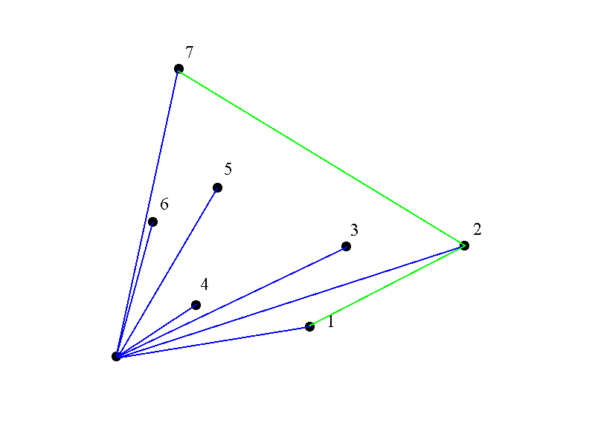
Graham’s Scan

Slide 31
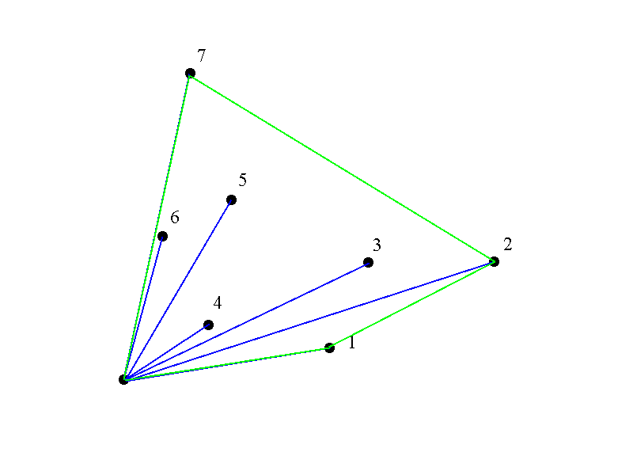
Graham’s Scan

Slide 32
Graham’s Runtime
Graham’s scan is O(n log n) due to initial sort of angles.

Slide 33
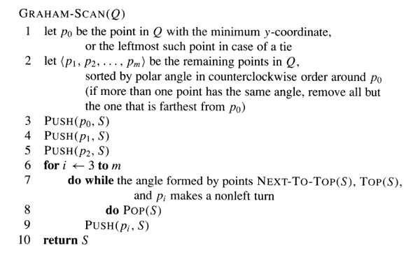
A more detailed algorithm

Slide 34
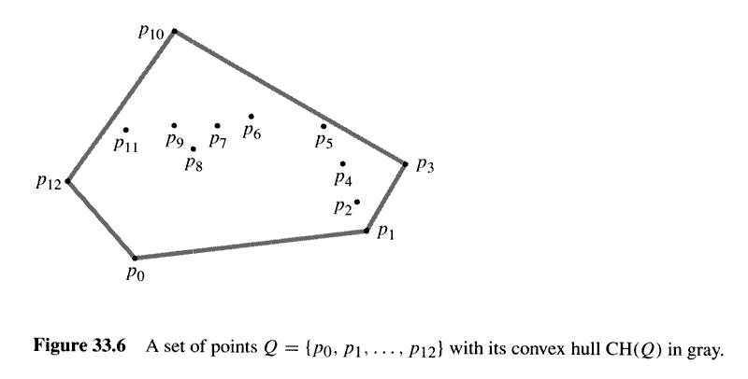

Slide 35
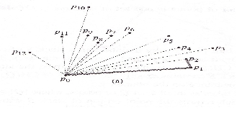
As shown, Grahams starts from a point (p0) and calculates all the angles it makes to all the points and sorts the angles in an order

Slide 36
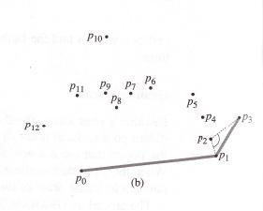
It selects the point with the least angle and starts traversing (P0-P1).
Then P1 to P2 & from P2 to P3 it realizes that it takes a right turn, so it backtracks and selects P1 – P3 directly, it being shorter

Slide 37
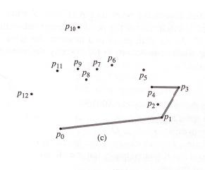
The algorithm continues, based on the above mentioned conditions till it reaches back to the initial point. Hence forming the Convex Hull as shown:

Slide 38
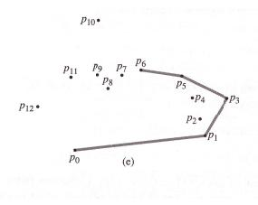
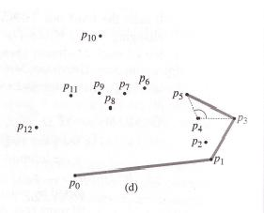
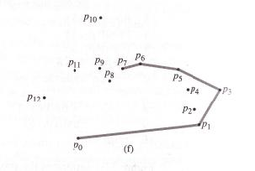
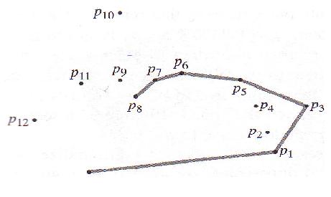

Slide 39
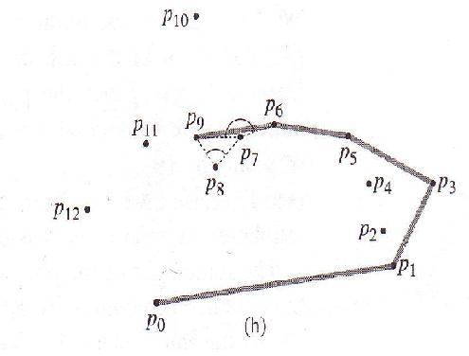
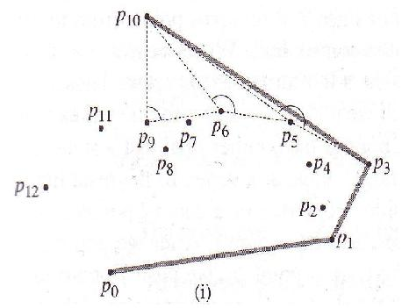
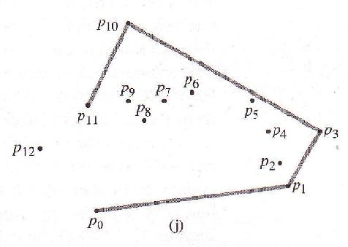
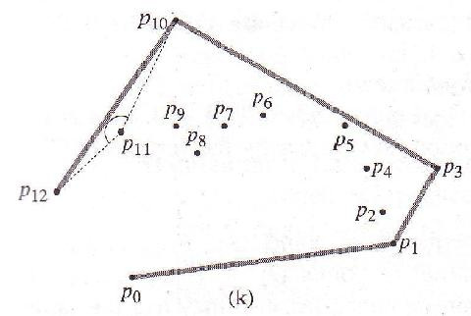

Slide 40
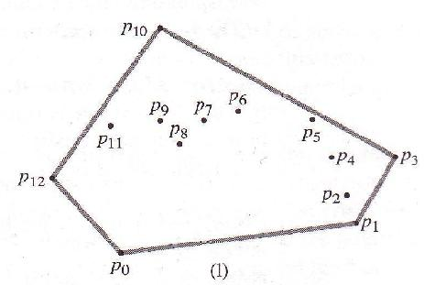
Once the initial point is reached the algorithm self terminates, and the Convex Hull is formed.

Slide 41
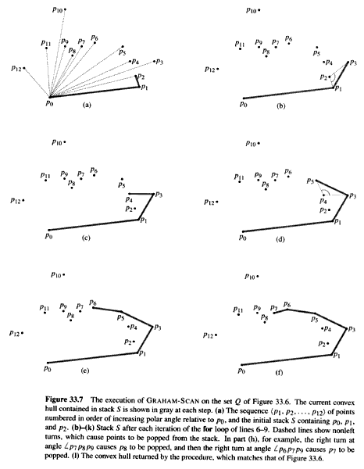

Slide 42
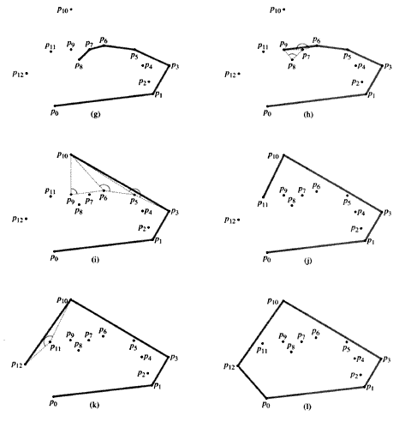

Slide 43
Number Theory
Importance of Number Theory
Before the dawn of computers, many viewed number theory as last bastion of “pure math” which could not be useful and must be enjoyed only for its aesthetic beauty.
No longer the case. Number theory is crucial for encryption algorithms. Of utmost importance to everyone from Bill Gates, to the CIA, to Osama Bin Laden.
E.G., of great importance in COMS 4180 “Network Security”.

Slide 44
Prime Numbers in Cryptography
Numbers used - Non-negative integers
Prime # - A positive integer > 1 is prime iff it is evenly
divisible (zero remainder) by only two other numbers =
1 & itself.
Divisor - If a & b are positive integers, and b ≠ 0, b is a
divisor of a (b divides a) if a = mb for some integer m,
such that a/b = m.
Divisors of 36: 1, 2, 3, 4, 6, 9, 12, 18, & 36 (not a prime #).
Divisors of 17 are: 1 & 17 (i.e., 17 is a prime #).

Slide 45
Properties of Divisors
Notation - b|a means b divides a with no remainder,
or b is a divisor of a.
If a|1, then a = 1 (if a divides 1, a must be 1 - any larger a
would produce a non-integer - fractional result).
If a|b and b|a, then a = b (if not =, one of the divisions
would produce a fraction - 2|4, but 4|2 isn’t true).
a|0 for all a ≠ 0 (i.e., 0/5 = 0, but 0/0 ≠ 0).

Slide 46
More Properties of Divisors
If a|k and a|l, then a|(mk + nl) for arbitrary m & n
That is, since a|k, then k must be of the form k = ak₁.
If a|l, then l is of the form l = al₁, for some integers, k₁
and l₁. Then: For a|(mk + nl), and substituting for k
& l, we have a|(mak₁ + nal₁) = a|a(mk₁ + nl₁), so a
divides (mk + nl). Example:
If a = 6; k = 36; l = 54, m = 2; n = 3
6|36 = 6: 6|54 = 9, and so does 6|(2x36 + 3x54)
and = (2x6x6 + 3x6x9) = 6(2x6 + 3x9), 6|(2x36 + 3x54)
This is of the form a|(m x k + n x l)

Slide 47
Divisor Theorem
THM: Let a, b, and c be integers. Then:
a|b ∧ a|c → a|(b + c )
a|b → a|bc
a|b ∧ b|c → a|c
EG:
17|34 ∧ 17|170 → 17|204
17|34 → 17|340
6|12 ∧ 12|144 → 6 | 144

Slide 48
Greatest Common Divisor
Objective 1. What is a greatest common divisor (GCD)
The greatest common divisor (GCD) of two natural numbers is the largest divisor shared by these two numbers.
Objective 1. What is a greatest common divisor (GCD)
Example: Find the GCD of 12 and 16
Divisors of 12: 1, 2, 3, 4, 6, 12
Multiples of 16: 1, 2, 4, 8, 16
The largest number found in each list is 4. This means that 4 is the greatest common divisor (GCD) of 12 and 16.

Slide 49
Modular Arithmetic
Several important cryptosystems make use of modular arithmetic. This is when the answer to a calculation is always in the range 0 – m where m is the modulus.
To calculate the value of n mod m, you take away as many multiples of m as possible until you are left with an answer between 0 and m.

Slide 50
If n is a negative number then you add as many multiples of m as necessary to get an answer in the range 0 – m.
Examples
17 mod 5 = 2 7 mod 11 = 7
20 mod 3 = 2 11 mod 11 = 0
-3 mod 11 = 8 -1 mod 11 = 10
25 mod 5 = 0 -11 mod 11 = 0

Slide 51
Two numbers r and s are said to be “congruent mod m” if
r mod m = s mod m
In this case we write r ≡ s mod m
The difference between r and s will be a multiple of m
So r-s = km for some value of k
E.g. 4 ≡9 ≡ 14≡19 ≡ -1 ≡-6 mod 5

Slide 52
A good thing about modular arithmetic is that the numbers you are working with will be kept relatively small. At each stage of an algorithm, the mod function should be applied.
Thus to multiply 39 * 15 mod 11 we first take mods to get
  39 mod 11 = 6 and 15 mod 11= 4
  The multiplication required is now
  6*4 mod 11 = 24 mod 11 = 2

Slide 53
The computational complexity of calculating a mod is O(b²)
Therefore the computational complexity of performing a multiplication mod m is O(b²)
And the complexity of calculating x^{n} mod m is O(b³) where b is the size of n.
Thus using modular arithmetic does not in general increase the complexity of algorithms.

Slide 54
Algorithm for modular exponentiation
To Compute x^{n} mod m
Initialise y=1, u=x mod m
Repeat
if n mod 2=1 then y=(y*u) mod m
n=n div 2
u=(u*u) mod m
Until n=0
Output y

Slide 55
Modular Division
What is 5 ÷ 3 mod 11?
We need to multiply 5 by the inverse of 3 mod 11
When you multiply a number by its inverse, the answer is 1.
Thus the inverse of 2 is ½ since 2* ½ = 1
The inverse of 3 mod 11 is 4 since 3*4=1 mod 11
Thus 5 ÷ 3 mod 11 = 5*4 mod 11 = 9 mod 11

Slide 56
It is relatively easy to find the inverse of x mod m using Euclids algorithm which has computational complexity O(b³) where b is the size of m.
Note however that x does not have an inverse mod m unless x and m are co-prime (have no factors in common).

Slide 57
Euclid’s GCD Algorithm
Euclid’s algorithm for computing the GCD repeatedly applies the formula
gcd(a, b) = gcd(b, a mod b)
Example
  gcd(412, 260) = 4
  Note b decreases by half in two iterations
Algorithm EuclidGCD(a, b)
Input integers a and b
Output gcd(a, b)
if b = 0
return a
else
return EuclidGCD(b, a mod b)
a | 412 | 260 | 152 | 108 | 44 | 20 | 4
b | 260 | 152 | 108 | 44 | 20 | 4 | 0
The overall running time of EuclidGCD is proportional to the number of recursive calls it make.

Slide 58
Prime Numbers
DEF: A number n ≥ 2 prime if it is only divisible by 1 and itself. A number n ≥ 2 which isn’t prime is called composite.
Q: Which of the following are prime?
0,1,2,3,4,5,6,7,8,9,10

Slide 59
Prime Numbers
A: 0, and 1 not prime since not positive and greater or equal to 2
2 is prime as 1 and 2 are only factors
3 is prime as 1 and 3 are only factors.
4,6,8,10 not prime as non-trivially divisible by 2.
5, 7 prime.
9 = 3 · 3 not prime.
Last example shows that not all odd numbers are prime.

Slide 60

Primality Testing
Prime numbers are very important in encryption schemes. Essential to be able to verify if a number is prime or not. It turns out that this is quite a difficult problem.
LEMMA: If n is a composite, then its smallest prime factor is ≤

Slide 61

Primality Testing.
Example
EG: Test if 139 and 143 are prime.
List all primes up to and check if they divide the numbers.
2: Neither is even
3: Sum of digits trick: 1+3+9 = 13, 1+4+3 = 8 so neither divisible by 3
5: Don’t end in 0 or 5
7: 140 divisible by 7 so neither div. by 7
11: Alternating sum trick: 1-3+9 = 7 so 139 not div. By 11. 1-4+3 = 0 so 143 is divisible by 11.
STOP! Next prime 13 need not be examined since bigger than .
Conclude: 139 is prime, 143 is composite.

Slide 62
Relatively Prime Numbers
Two numbers are relatively prime if their gcd (greatest
common divisor) or gcf (greatest common factor) = 1.
gcd (a, b) means the greatest common divisor of a & b.
If gcd (a, b) = c, then c is a divisor of a & b (i.e., c|a, c|b),
and any divisor of c is a divisor of a & b
(i.e., d|c means d|a & d|b).

Slide 63
Definition
Factor – a number that is multiplied by another to give a product.
7 x 8 = 56
Factors

Slide 64
Definition
Factor – a number that divides evenly into another.
56 ÷ 8 = 7
Factor

Slide 65
Definition
Prime Number – a number that has only two factors, itself and 1.
7
7 is prime because the only numbers
that will divide into it evenly are 1 and 7.

Slide 66
Hundreds Chart
On graph paper, make a chart of the numbers from 1 to 100, with 10 numbers in each row.

Slide 67
Hundreds Chart
1 | 2 | 3 | 4 | 5 | 6 | 7 | 8 | 9 | 10
11 | 12 | 13 | 14 | 15 | 16 | 17 | 18 | 19 | 20
21 | 22 | 23 | 24 | 25 | 26 | 27 | 28 | 29 | 30
31 | 32 | 33 | 34 | 35 | 36 | 37 | 38 | 39 | 40
41 | 42 | 43 | 44 | 45 | 46 | 47 | 48 | 49 | 50
51 | 52 | 53 | 54 | 55 | 56 | 57 | 58 | 59 | 60
61 | 62 | 63 | 64 | 65 | 66 | 67 | 68 | 69 | 70
71 | 72 | 73 | 74 | 75 | 76 | 77 | 78 | 79 | 80
81 | 82 | 83 | 84 | 85 | 86 | 87 | 88 | 89 | 90
91 | 92 | 93 | 94 | 95 | 96 | 97 | 98 | 99 | 100

Slide 68
1 – Cross out 1; it is not prime.
1 | 2 | 3 | 4 | 5 | 6 | 7 | 8 | 9 | 10
11 | 12 | 13 | 14 | 15 | 16 | 17 | 18 | 19 | 20
21 | 22 | 23 | 24 | 25 | 26 | 27 | 28 | 29 | 30
31 | 32 | 33 | 34 | 35 | 36 | 37 | 38 | 39 | 40
41 | 42 | 43 | 44 | 45 | 46 | 47 | 48 | 49 | 50
51 | 52 | 53 | 54 | 55 | 56 | 57 | 58 | 59 | 60
61 | 62 | 63 | 64 | 65 | 66 | 67 | 68 | 69 | 70
71 | 72 | 73 | 74 | 75 | 76 | 77 | 78 | 79 | 80
81 | 82 | 83 | 84 | 85 | 86 | 87 | 88 | 89 | 90
91 | 92 | 93 | 94 | 95 | 96 | 97 | 98 | 99 | 100

Slide 69
Hint For Next Step
Remember all numbers divisible by 2 are even numbers.

Slide 70
2 – Leave 2; cross out multiples of 2
1 | 2 | 3 | 4 | 5 | 6 | 7 | 8 | 9 | 10
11 | 12 | 13 | 14 | 15 | 16 | 17 | 18 | 19 | 20
21 | 22 | 23 | 24 | 25 | 26 | 27 | 28 | 29 | 30
31 | 32 | 33 | 34 | 35 | 36 | 37 | 38 | 39 | 40
41 | 42 | 43 | 44 | 45 | 46 | 47 | 48 | 49 | 50
51 | 52 | 53 | 54 | 55 | 56 | 57 | 58 | 59 | 60
61 | 62 | 63 | 64 | 65 | 66 | 67 | 68 | 69 | 70
71 | 72 | 73 | 74 | 75 | 76 | 77 | 78 | 79 | 80
81 | 82 | 83 | 84 | 85 | 86 | 87 | 88 | 89 | 90
91 | 92 | 93 | 94 | 95 | 96 | 97 | 98 | 99 | 100

Slide 71
Hint For Next Step
To find multiples of 3, add the digits of a number; see if you can divide this number evenly by 3; then the number is a multiple of 3.
2 6 7
Total of digits = 15
3 divides evenly into 15
267 is a multiple of 3

Slide 72
3– Leave 3; cross out multiples of 3
1 | 2 | 3 | 4 | 5 | 6 | 7 | 8 | 9 | 10
11 | 12 | 13 | 14 | 15 | 16 | 17 | 18 | 19 | 20
21 | 22 | 23 | 24 | 25 | 26 | 27 | 28 | 29 | 30
31 | 32 | 33 | 34 | 35 | 36 | 37 | 38 | 39 | 40
41 | 42 | 43 | 44 | 45 | 46 | 47 | 48 | 49 | 50
51 | 52 | 53 | 54 | 55 | 56 | 57 | 58 | 59 | 60
61 | 62 | 63 | 64 | 65 | 66 | 67 | 68 | 69 | 70
71 | 72 | 73 | 74 | 75 | 76 | 77 | 78 | 79 | 80
81 | 82 | 83 | 84 | 85 | 86 | 87 | 88 | 89 | 90
91 | 92 | 93 | 94 | 95 | 96 | 97 | 98 | 99 | 100

Slide 73
Hint For the Next Step
To find the multiples of 5 look for numbers that end with the digit 0 and 5.
385 is a multiple of 5
& 890 is a multiple of 5
because the last digit
ends with 0 or 5.

Slide 74
4– Leave 5; cross out multiples of 5
1 | 2 | 3 | 4 | 5 | 6 | 7 | 8 | 9 | 10
11 | 12 | 13 | 14 | 15 | 16 | 17 | 18 | 19 | 20
21 | 22 | 23 | 24 | 25 | 26 | 27 | 28 | 29 | 30
31 | 32 | 33 | 34 | 35 | 36 | 37 | 38 | 39 | 40
41 | 42 | 43 | 44 | 45 | 46 | 47 | 48 | 49 | 50
51 | 52 | 53 | 54 | 55 | 56 | 57 | 58 | 59 | 60
61 | 62 | 63 | 64 | 65 | 66 | 67 | 68 | 69 | 70
71 | 72 | 73 | 74 | 75 | 76 | 77 | 78 | 79 | 80
81 | 82 | 83 | 84 | 85 | 86 | 87 | 88 | 89 | 90
91 | 92 | 93 | 94 | 95 | 96 | 97 | 98 | 99 | 100

Slide 75
5– Leave 7; cross out multiples of 7
1 | 2 | 3 | 4 | 5 | 6 | 7 | 8 | 9 | 10
11 | 12 | 13 | 14 | 15 | 16 | 17 | 18 | 19 | 20
21 | 22 | 23 | 24 | 25 | 26 | 27 | 28 | 29 | 30
31 | 32 | 33 | 34 | 35 | 36 | 37 | 38 | 39 | 40
41 | 42 | 43 | 44 | 45 | 46 | 47 | 48 | 49 | 50
51 | 52 | 53 | 54 | 55 | 56 | 57 | 58 | 59 | 60
61 | 62 | 63 | 64 | 65 | 66 | 67 | 68 | 69 | 70
71 | 72 | 73 | 74 | 75 | 76 | 77 | 78 | 79 | 80
81 | 82 | 83 | 84 | 85 | 86 | 87 | 88 | 89 | 90
91 | 92 | 93 | 94 | 95 | 96 | 97 | 98 | 99 | 100

Slide 76
6–Leave 11; cross out multiples of 11
1 | 2 | 3 | 4 | 5 | 6 | 7 | 8 | 9 | 10
11 | 12 | 13 | 14 | 15 | 16 | 17 | 18 | 19 | 20
21 | 22 | 23 | 24 | 25 | 26 | 27 | 28 | 29 | 30
31 | 32 | 33 | 34 | 35 | 36 | 37 | 38 | 39 | 40
41 | 42 | 43 | 44 | 45 | 46 | 47 | 48 | 49 | 50
51 | 52 | 53 | 54 | 55 | 56 | 57 | 58 | 59 | 60
61 | 62 | 63 | 64 | 65 | 66 | 67 | 68 | 69 | 70
71 | 72 | 73 | 74 | 75 | 76 | 77 | 78 | 79 | 80
81 | 82 | 83 | 84 | 85 | 86 | 87 | 88 | 89 | 90
91 | 92 | 93 | 94 | 95 | 96 | 97 | 98 | 99 | 100

Slide 77
All the numbers left are prime
1 | 2 | 3 | 4 | 5 | 6 | 7 | 8 | 9 | 10
11 | 12 | 13 | 14 | 15 | 16 | 17 | 18 | 19 | 20
21 | 22 | 23 | 24 | 25 | 26 | 27 | 28 | 29 | 30
31 | 32 | 33 | 34 | 35 | 36 | 37 | 38 | 39 | 40
41 | 42 | 43 | 44 | 45 | 46 | 47 | 48 | 49 | 50
51 | 52 | 53 | 54 | 55 | 56 | 57 | 58 | 59 | 60
61 | 62 | 63 | 64 | 65 | 66 | 67 | 68 | 69 | 70
71 | 72 | 73 | 74 | 75 | 76 | 77 | 78 | 79 | 80
81 | 82 | 83 | 84 | 85 | 86 | 87 | 88 | 89 | 90
91 | 92 | 93 | 94 | 95 | 96 | 97 | 98 | 99 | 100

Slide 78
The Prime Numbers from 1 to 100 are as follows:
2,3,5,7,11,13,17,19,
23,31,37,41,43,47,
53,59,61,67,71,73,
79,83,89,97

